Slide 1
Foreground-background separation in video
By Brian Nguyen & Anthony Nguyen

Slide 2
Foreground-background Issue
While you are trying to take a moving object from a video, if the object has excessive movement it could be hard to track, and lose important information in the foreground
Splitting the image into a foreground and background, and being able to track it.
The pixel values may be different due to certain circumstances, and depending on the brightness could also vary. Due to this- the foreground detection may be difficult to be accurate.

Slide 3
Literature We Reviewed
Real-time Foreground-background segmentation using codebook model - Kyungnam Kim, Thanarat H. Chalidabhongse, David Harwood, Larry Davis
Motion-Based Background Subtraction using Adaptive Kernel Density Estimation- Anurag Mittal, Nikos Paragios
Segmentation Foreground Objects from a Dynamic Textured Background via a Robust Kalman Filter - Jing Zhong and Stand Sclaroff
Background Modeling and Subtraction of Dynamic Scenes - Antoine Monnet, Anurag Mittal, Nikos Paragios, Visvanathan Ramesh

Slide 4
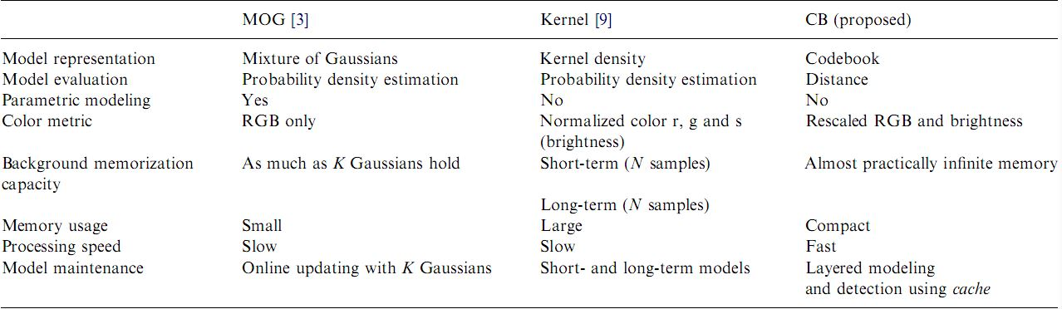
What We Got From The Literature
Extracting moving objects from a video sequences captured using a static camera.
Background subtraction is to subtract or difference the current image of the background model
With codebook- it can handle multiple backgrounds and it eliminates most compression artifacts.
There are three different ways to take an image from the background of a videos and they are MOG, Kernel, and codebook. Each has their own unique way. They have their strengths and weaknesses

Slide 5
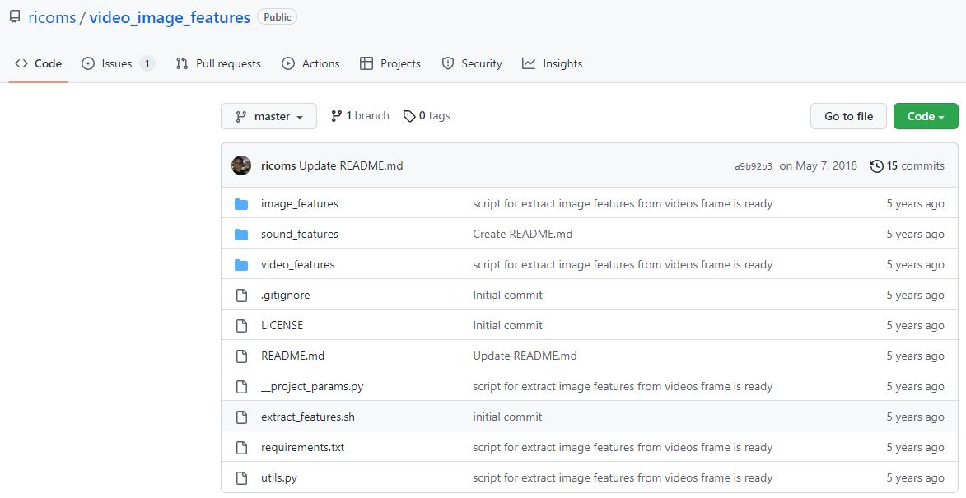
Our Previous Mistakes & Issues We Ran Into
We first thought that it would be best to write the program in python and we looked up different libraries to use
We found a github that could use Color Histogram, hog, inceptionV3 Imagenet, LBP, ORB
Then we were not sure how to implement it to separate the background of the video data

Slide 6
Research & Development Plan
We decided to go with MatLab and we took some of the courses that matlab provided to understand how to use the program
https://www.mathworks.com/videos/video-processing-in-matlab-68745.html
Doing more research about the topic and to understand how to use codebook within MatLab
We want to further separate the foreground and background. We are still figuring how to approach the project and problem

Slide 7
Summary Of Results
With MatLab we are able to detect the movements of the foreground
We are figuring out how to separate the foreground and background into separate parts to become more noticeable

Slide 8

Preliminary Results

